Slide 1
بسم الله الرحمن الرحیم

Slide 2


Ministry Of Higher Education
Kabul University
Information and Communication Technology Faculty
Information Science and Engineering Department
Prepared by: Sarwar Ebrahimi
Class: ISE 3rd ,5th semester
Instructor:Pro.Gharani
Date:9/12/2025

Slide 3
Temporary Tables
A temporary table is a database object that is temporarily stored and managed by the database system. Temporary tables can be local or global.
Local temporary tables have physical representation—that is, they are stored in the tempdb system database. They are specified with the prefix # (for example, #table_name).
A local temporary table is owned by the session that created it and is visible only to that session.
automatically dropped when the creating session terminates
Global temporary tables are visible to any user and any connection after they are created, and are deleted when all users that are referencing the table disconnect from the database server.
specified with the prefix ##.

Slide 4
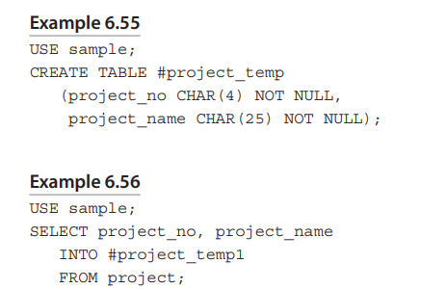
Temporary Tables

Slide 5
Join Operator
Transact-SQL provides the join operator, which retrieves data from more than one table.
The most important operator for relational database systems. —nonredundant data
The UNION operator also attaches two or more tables. Join operator “joins” two or more tables using just one SELECT.
1- Natural join 2-Cartesian product (cross join) 3- Outer join 4- Theta join, self-join, and semi-join.
Two Syntax: 1- Explicit join syntax (ANSI SQL:1992 join syntax) 2-Implicit join syntax (old-style join syntax.
CROSS JOIN • [INNER] JOIN • LEFT [OUTER] JOIN • RIGHT [OUTER] JOIN • FULL [OUTER] JOIN

Slide 6
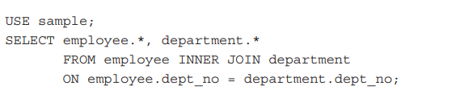
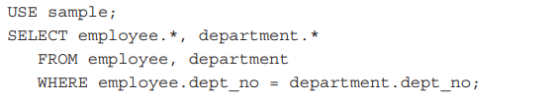
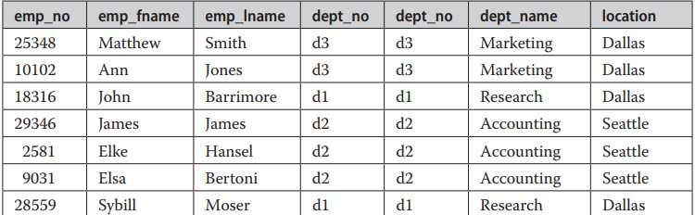
Natural Join -----> Inner Join
Natural Join = equi-join
Explicit
Implicit
Result:

Slide 7
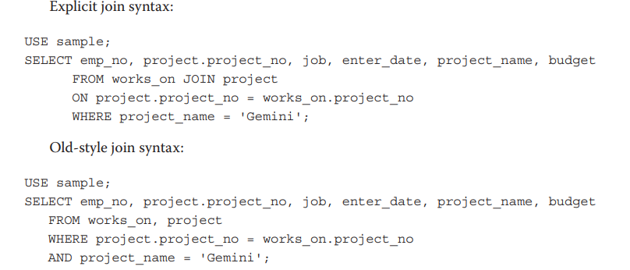
Natural Join -----> Inner Join
The names of columns in a SELECT statement can be qualified. “Qualifying” a column name means that, to avoid any possible ambiguity about which table the column belongs to, the column name is preceded by its table name (or the alias of the table), separated by a period: table_name.column_name. Qualified names is generally recommended for readability.

Slide 8
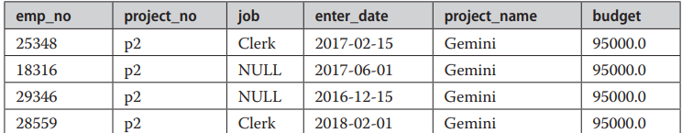
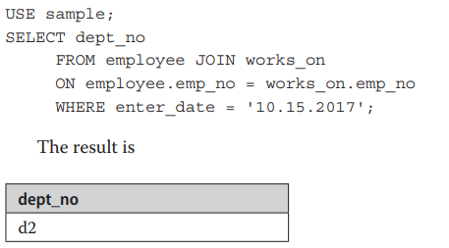
Natural Join -----> Inner Join
The Result
Another Example

Slide 9
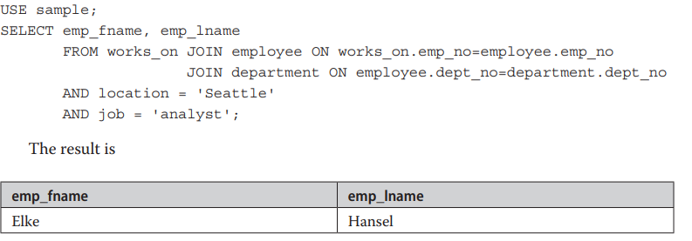
Joining More Than Two Tables
No upper limit on the number of tables that can be joined using a SELECT statement.
One join condition always combines two tables! Maximum number of tables that can be joined in a SELECT statement is 64.
Example

Slide 10
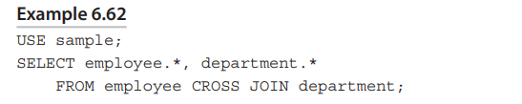
Cartesian Product
A Cartesian product combines each row of the first table with each row of the second table. In general, the Cartesian product of two tables such that the first table has n rows and the second table has m rows will produce a result with n times m rows (or n*m). Thus, the result set in Example 6.62 contains 7*3 = 21 rows.
In Practical it is Unusual !!!

Slide 11

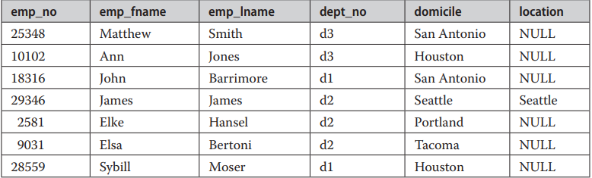
Outer Join
Sometimes it is necessary to retrieve, in addition to the matching rows, the unmatched rows from one or both of the tables. Such an operation is called an outer join. Right Outer Join, Left Outer Join, Full Outer Join.
Example
Result

Slide 12
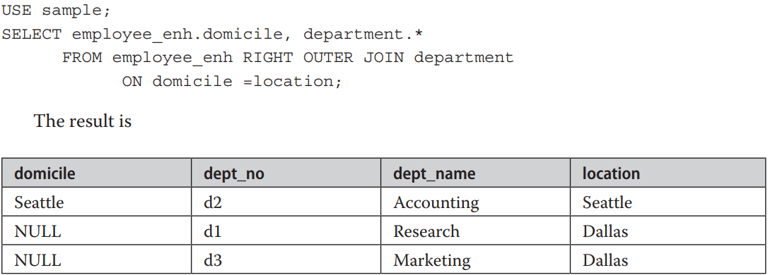
Right Outer Join
Example
Result

Slide 13
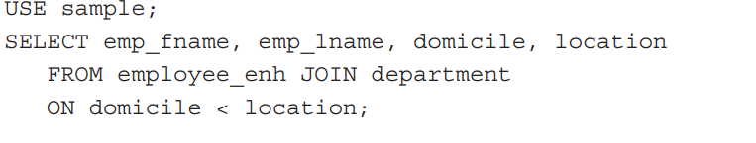
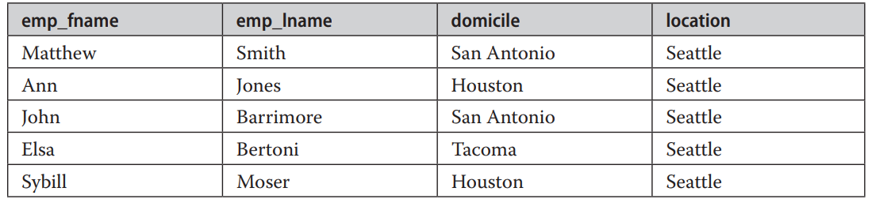
Theta Join
Join columns need not be compared using the equality sign. A join operation using a general join condition is called a theta join.
Example
Result

Slide 14
Self-Join, or Joining a Table with Itself
In addition to joining two or more different tables, a natural join operation can also be applied to a single table. In this case, the table is joined with itself, whereby a single column of the table is compared with itself. The comparison of a column with itself means that the table name appears twice in the FROM clause of a SELECT statement. Therefore, you need to be able to reference the name of the same table twice. This can be accomplished using at least one alias name. The same is true for the column names in the join condition of a SELECT statement. In order to distinguish both column names, you use the qualified names.

Slide 15
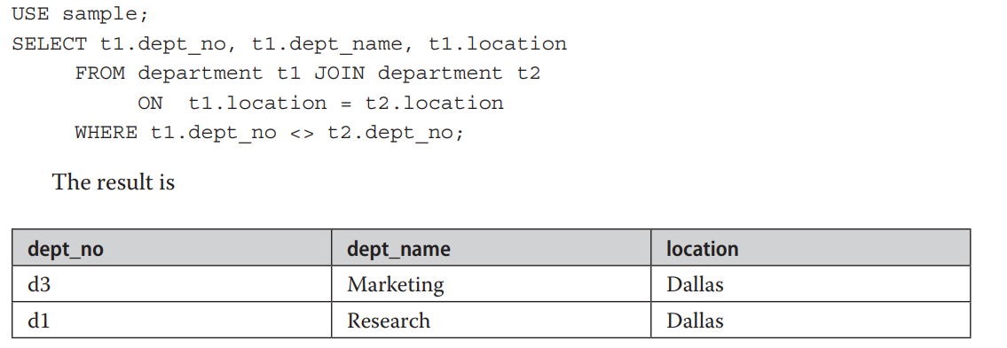
Self-Join, or Joining a Table with Itself
.
Example

Slide 16
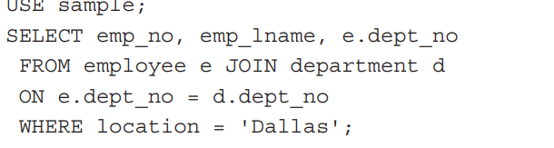
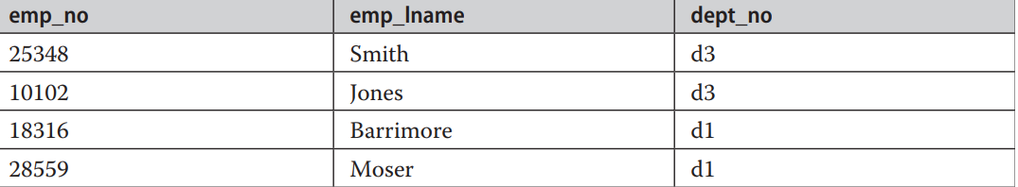
Semi-Join
Semi-Join The semi-join is similar to the natural join, but the result of the semi-join is only the set of all rows from one table where one or more matches are found in the second table
Query
Result

Slide 17
Thank You!
Reference : SQL Server 2019 A Beginner’s Guide 7th Edition

